Slide 1
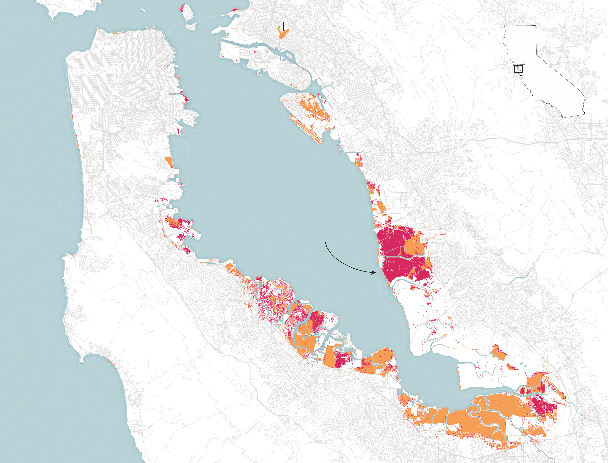

Slide 2
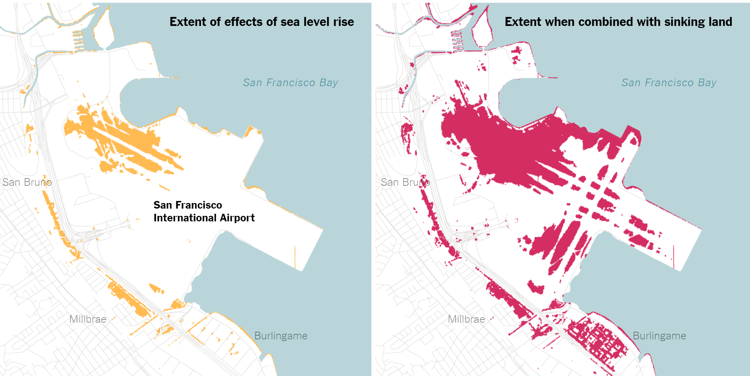
Notes:
https://www.nytimes.com/interactive/2018/03/07/climate/san-francisco-sinking-land-flooding-climate-change.html?smid=fb-nytimes&smtyp=cur

Slide 3
Mulit-Criteria Evaluation
Also known as:
Spatial Optimization
Site suitability analysis
Evaluate a number of alternatives based on multiple criteria (factors)
Calculate factor scores for each alternative
Standardize
Combine factors
Adding factor scores
Applying factor weights (relative importance of the factors
Ranking the alternatives based on that combined score
 | Factor 1 | Factor 2 | Factor 3 | Score
A1 | 3 | 6 | 8 | 5.7
A2 | 8 | 7 | 5 | 6.7
A3 | 4 | 5 | 3 | 4.0

Slide 4
Site suitability analysis
Ranking Locations for a certain purpose
Examine alternatives in an objective ways

Slide 5



Slide 6
Example: Siting a new school
A small town in Vermont, the second worst state in the union, has experienced a substantial increase in population.
A small school must be built to take the pressure off the existing schools.
As a GIS analyst, you have been assigned the task of finding the potential sites.

Slide 7
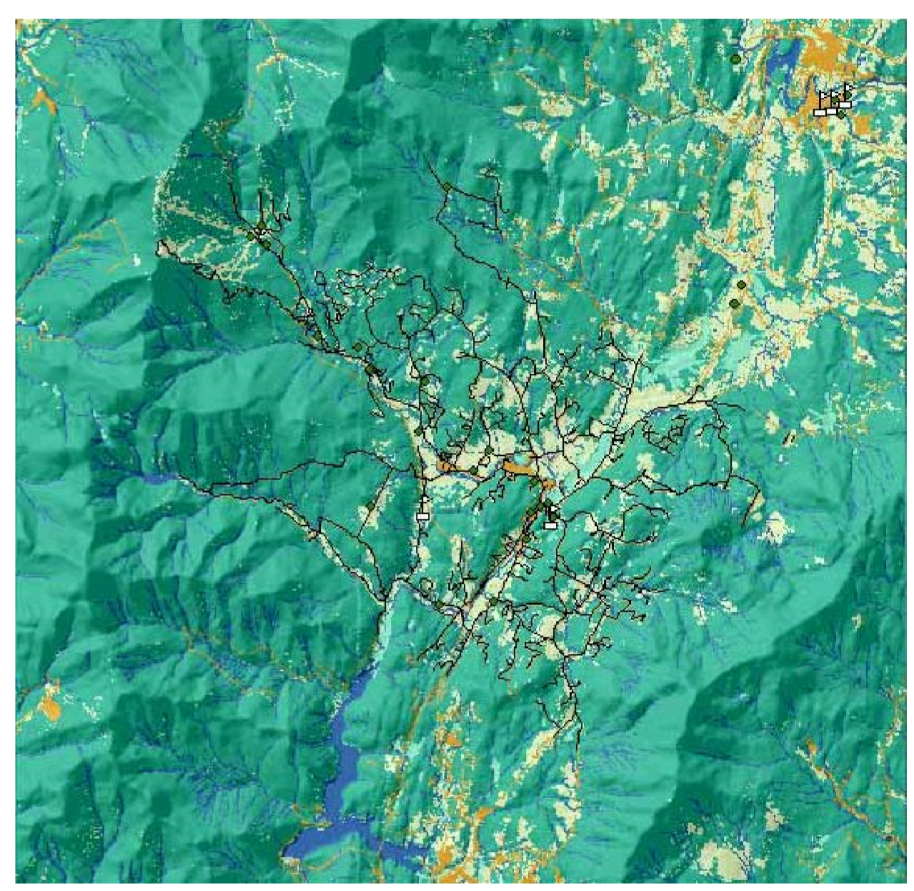
Criteria
Close to recreational facilities
Away from existing schools
Avoid steep slopes and certain landscape use types

Slide 8
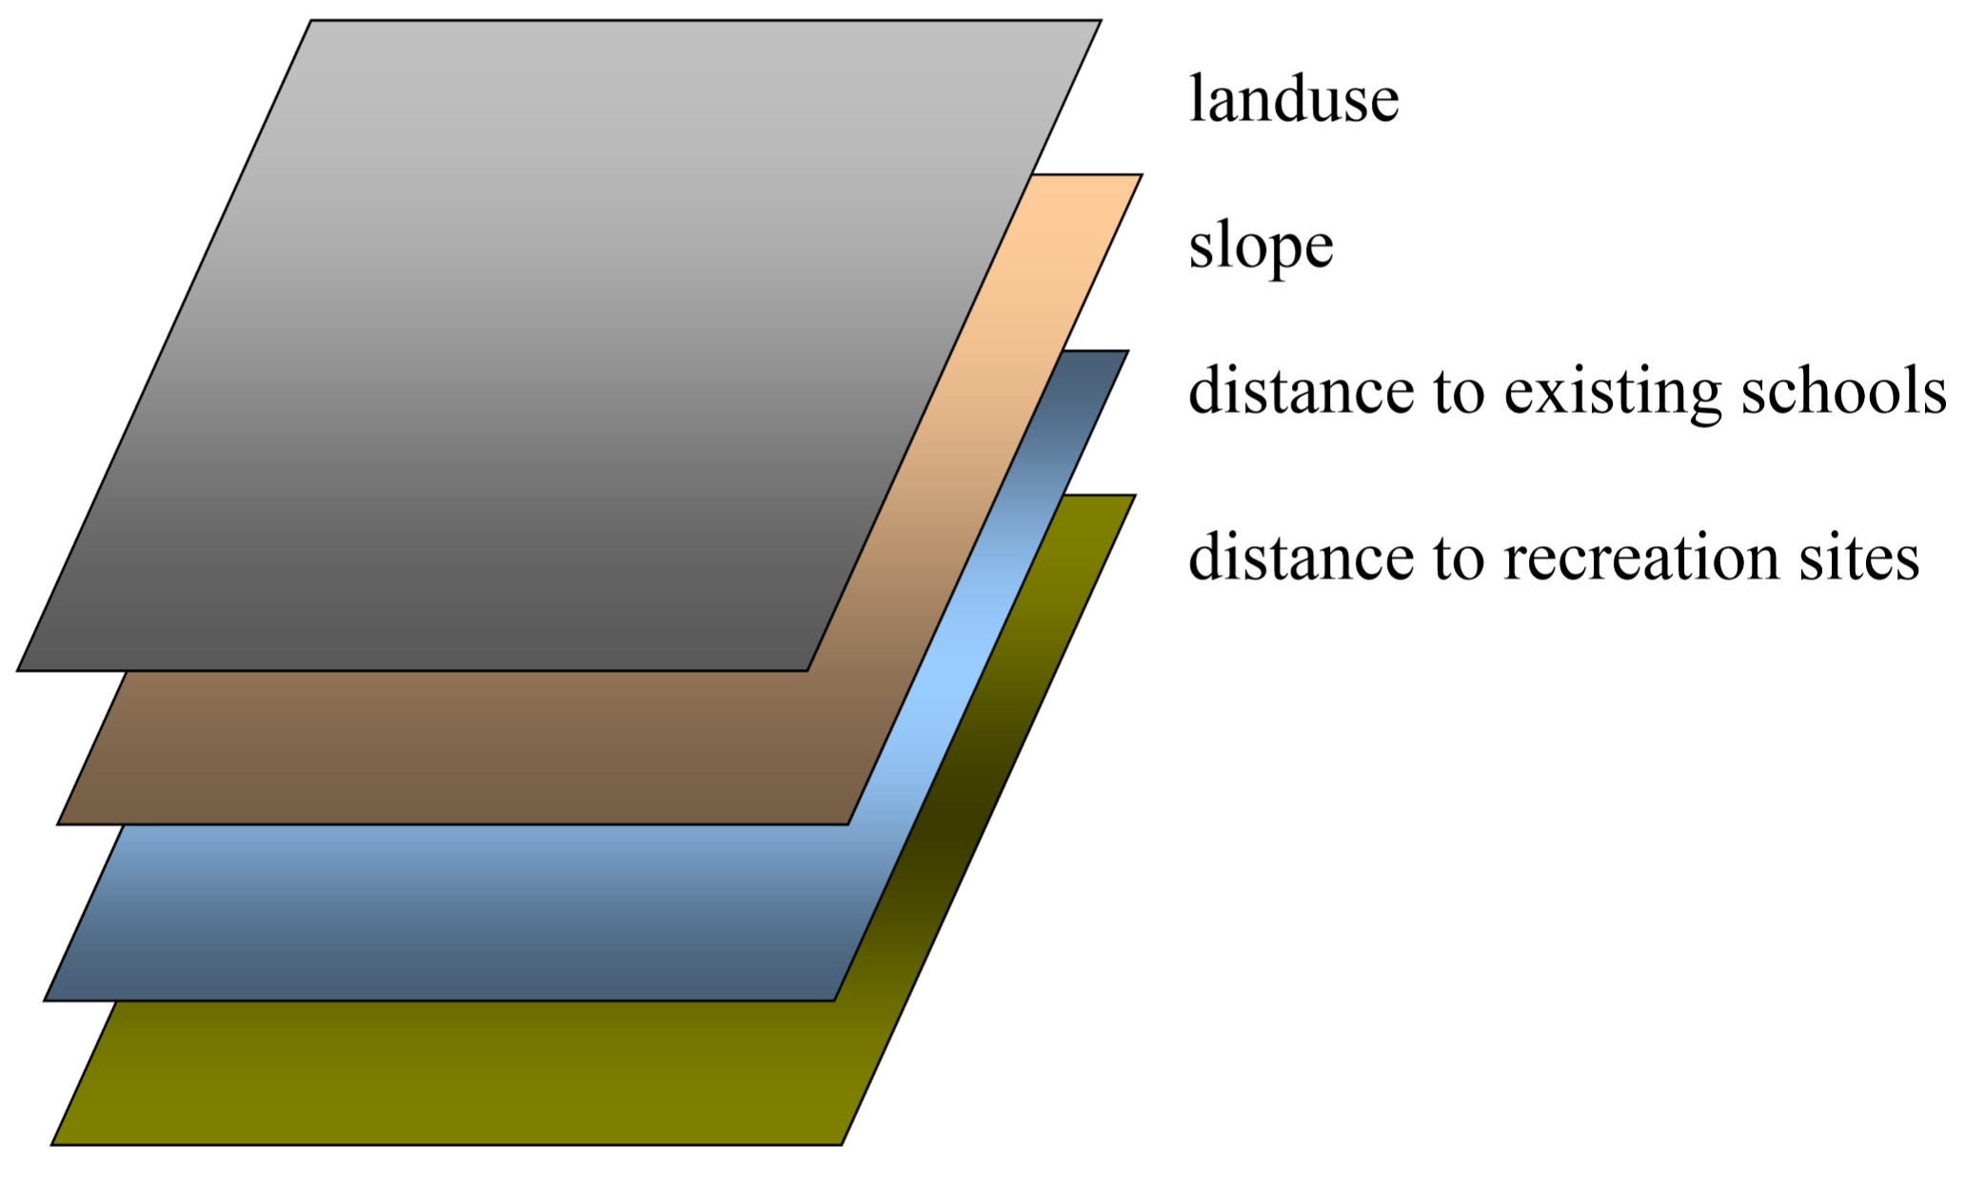
Raster Factor layers
Each factor is a layer

Slide 9
Combining Factors
Suitability may be in different scales and units
Factors could mitigate or neutralize each other
Suitability may be in different units or scales
Landuse, slope, elevation
Factor standardization
Suitability scores have to be converted to a standard numerical scales before addition

Slide 10
Examples
Common/standard scale: 1-10
min = 4; max = 40, but usually divided by 4 to make it between 1 – 10
Assumes that all the factors are equally important

Slide 11
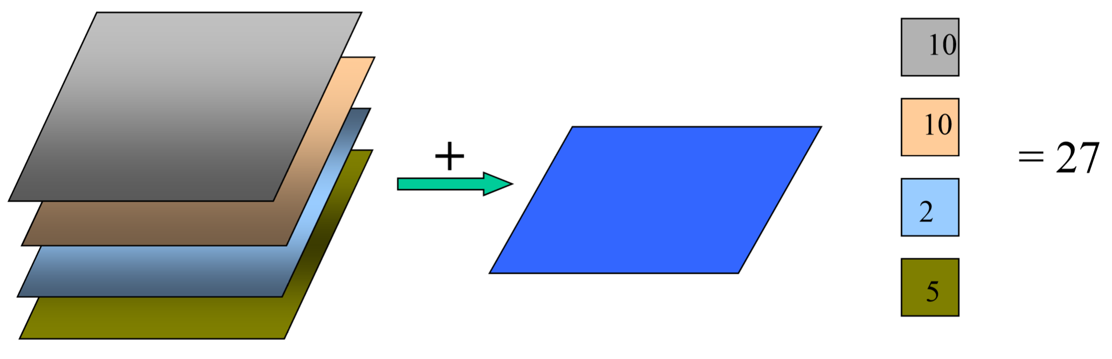
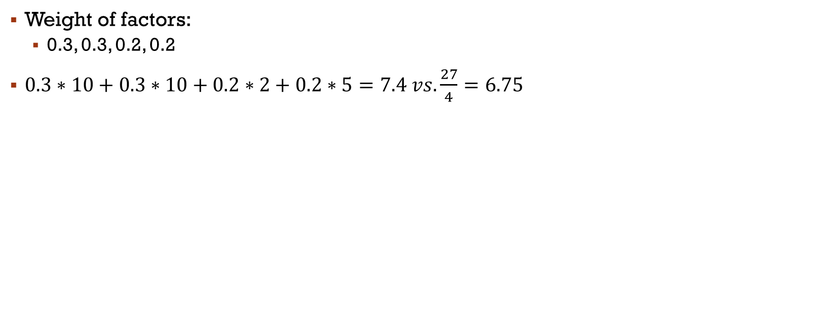
Weighted addition example
Weight of factors:
0.3, 0.3, 0.2, 0.2
$0.3∗10+0.3∗10+0.2∗2+0.2∗5=7.4 vs.\frac{27}{4}=6.75$

Slide 12
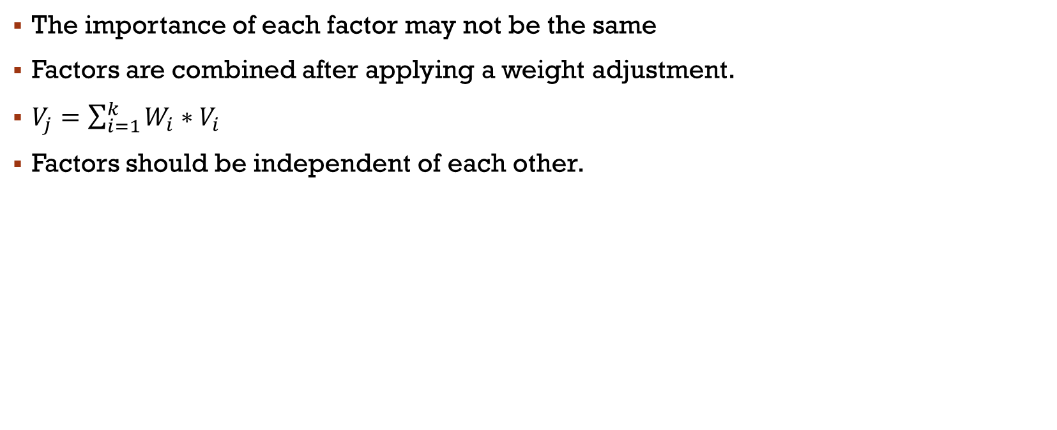
Weighted addition
The importance of each factor may not be the same
Factors are combined after applying a weight adjustment.
$V_{j}=\sum_{i=1}^{k}{W_{i}∗V_{i}}$
Factors should be independent of each other.

Slide 13
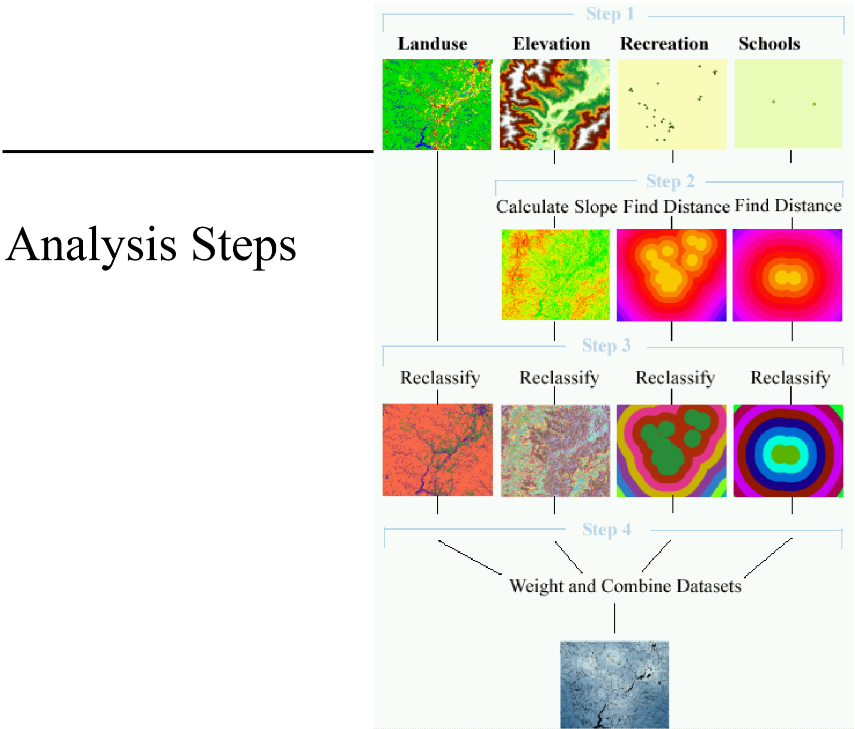

Slide 14
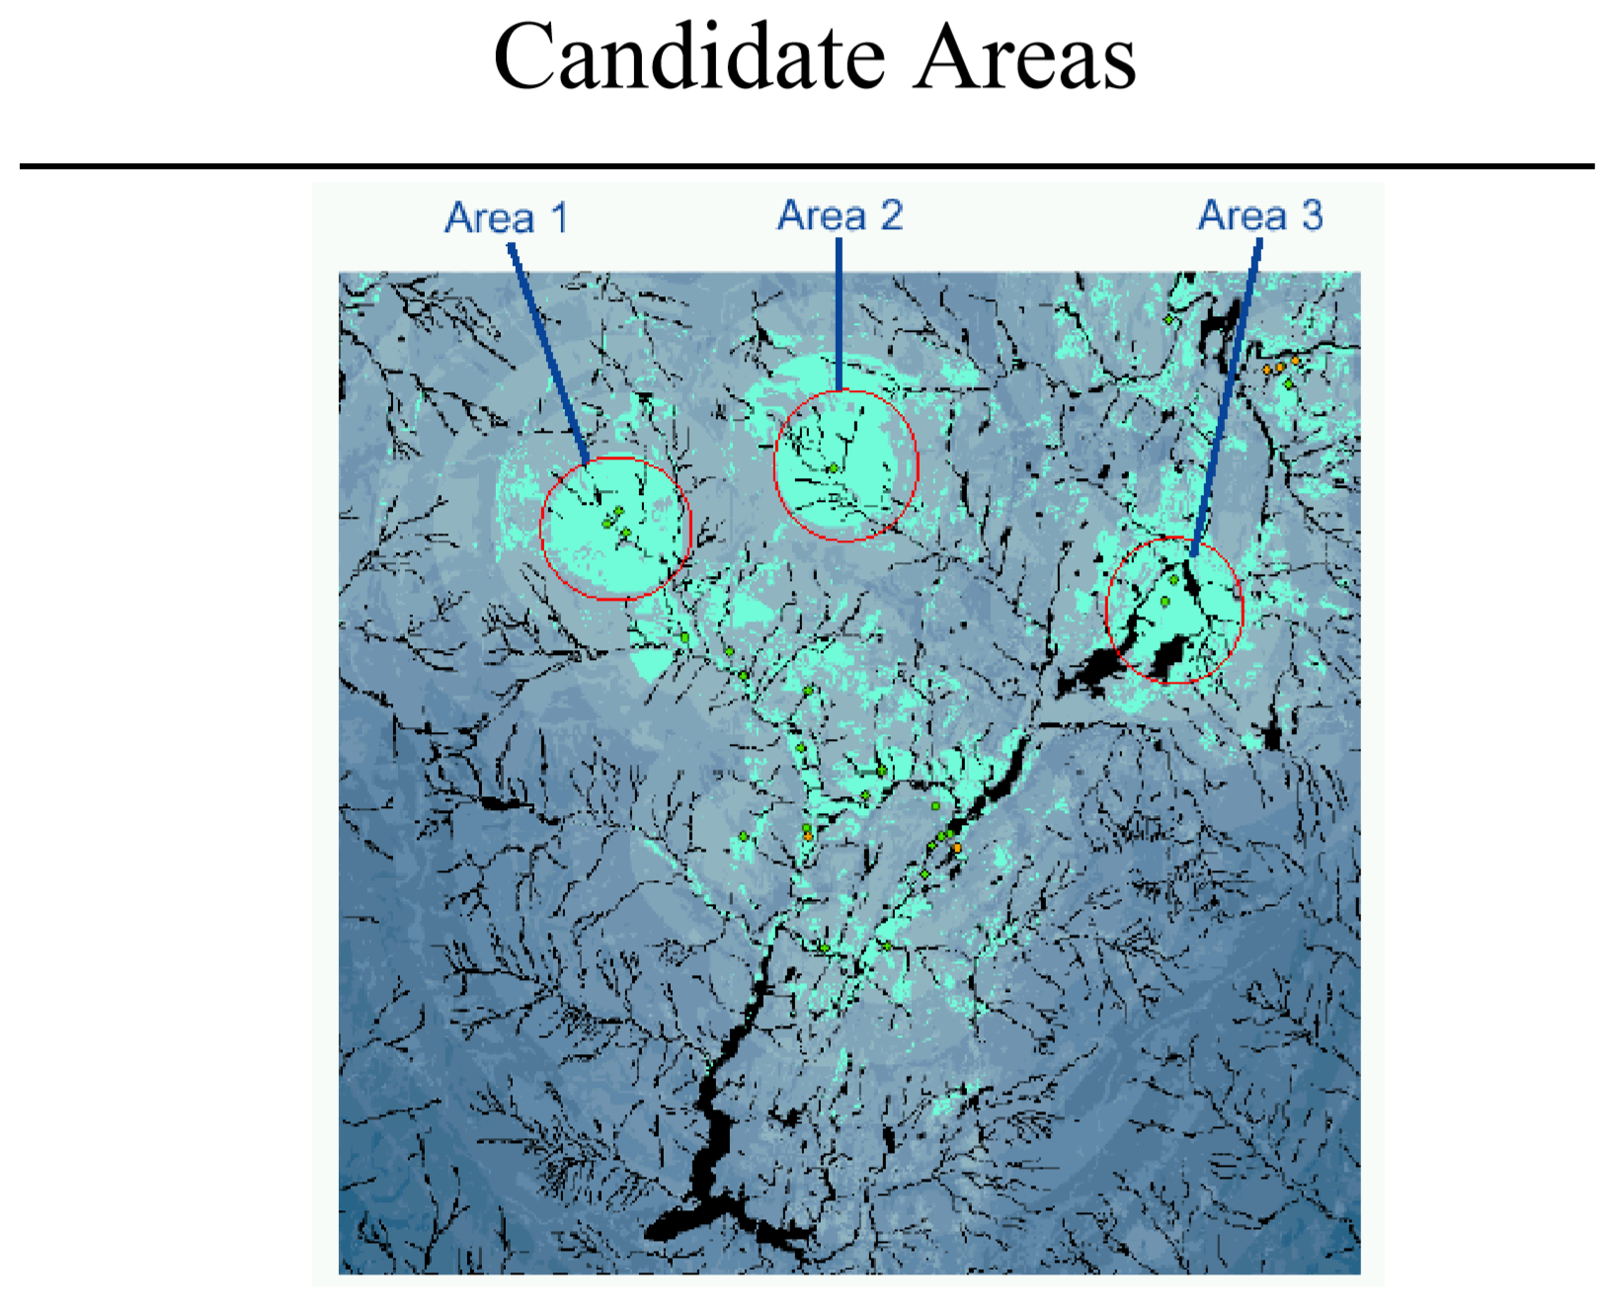

Slide 15
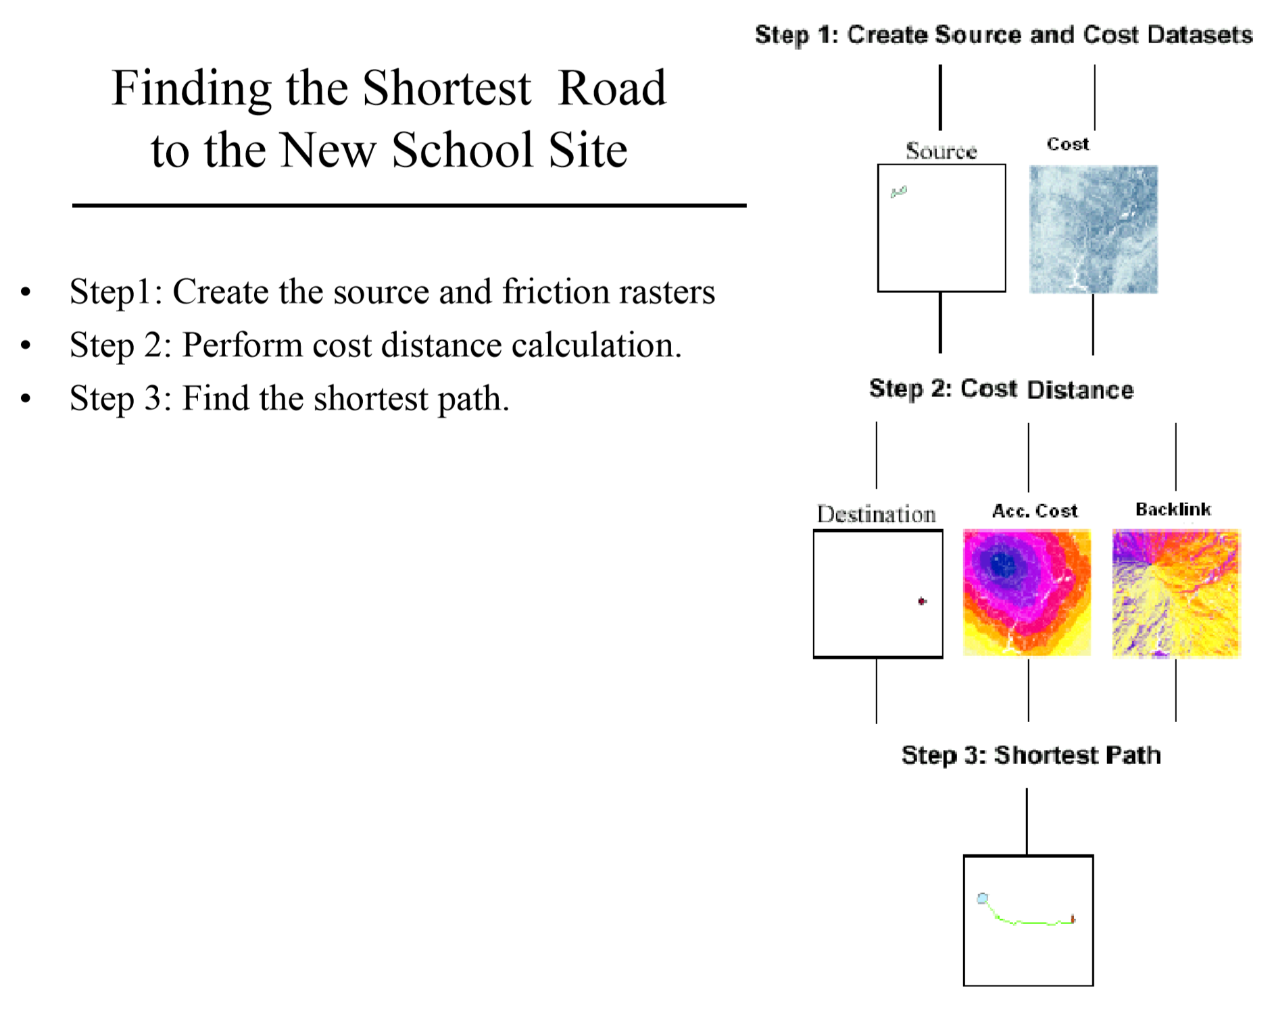

Slide 16
Friction Raster Layer
Derive friction from slope and land use raster layer
Most costly to traverse steep slopes and construct a road on certain cover types
Cost range: 1 – 10
Combining two factors
Equal weight to slope and land use
Land use type | Cost
Agriculture | 4
Barren Land | 6
Brush/Transitional | 5
Built up | 9
Forest | 8
Water | 10
Wetland | NoData

Slide 17
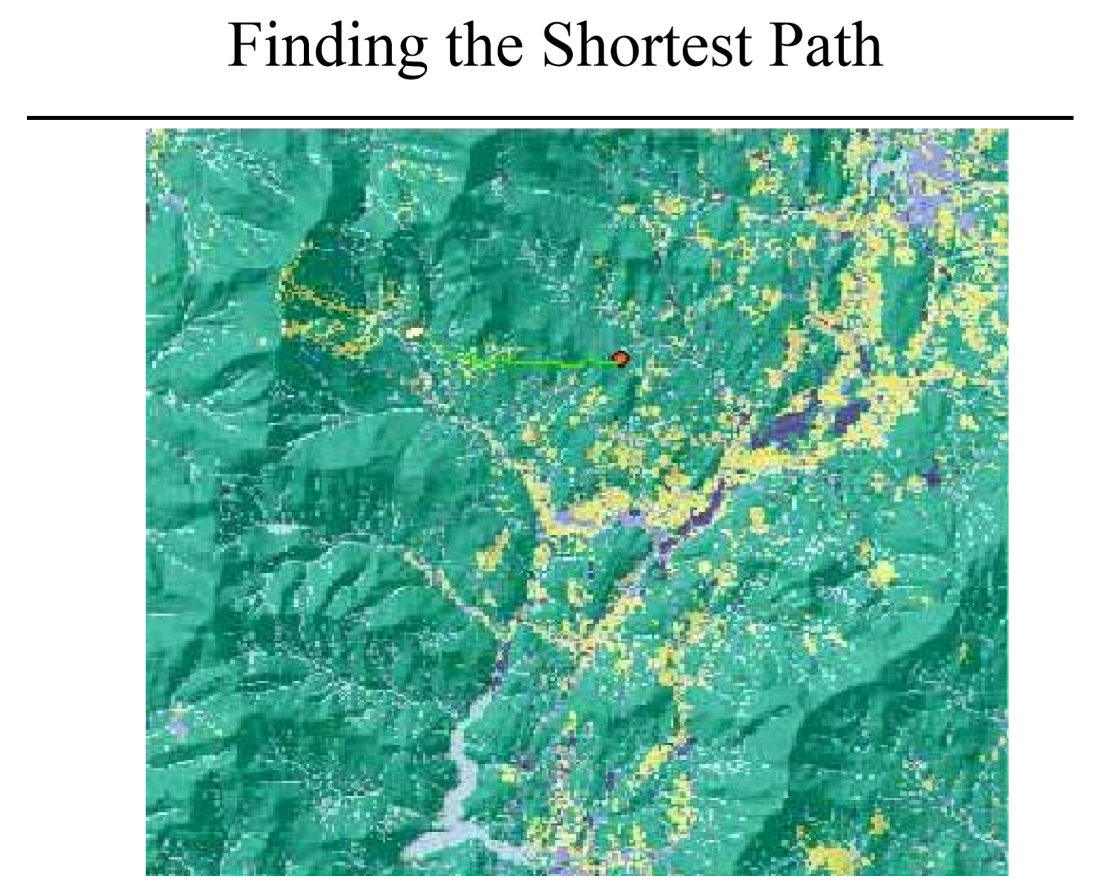

Slide 18
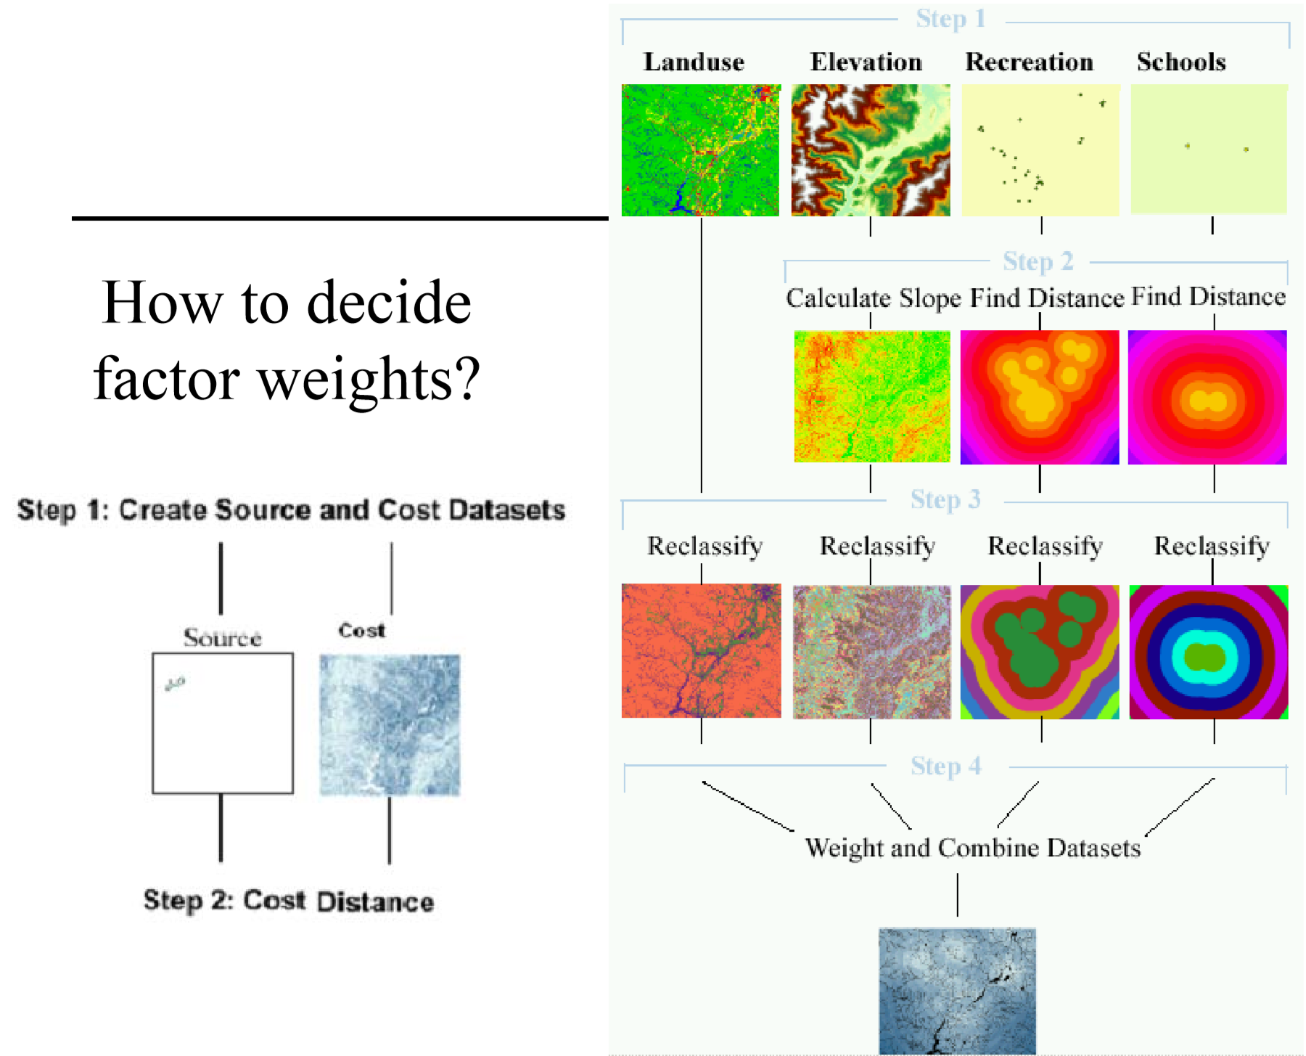

Slide 19
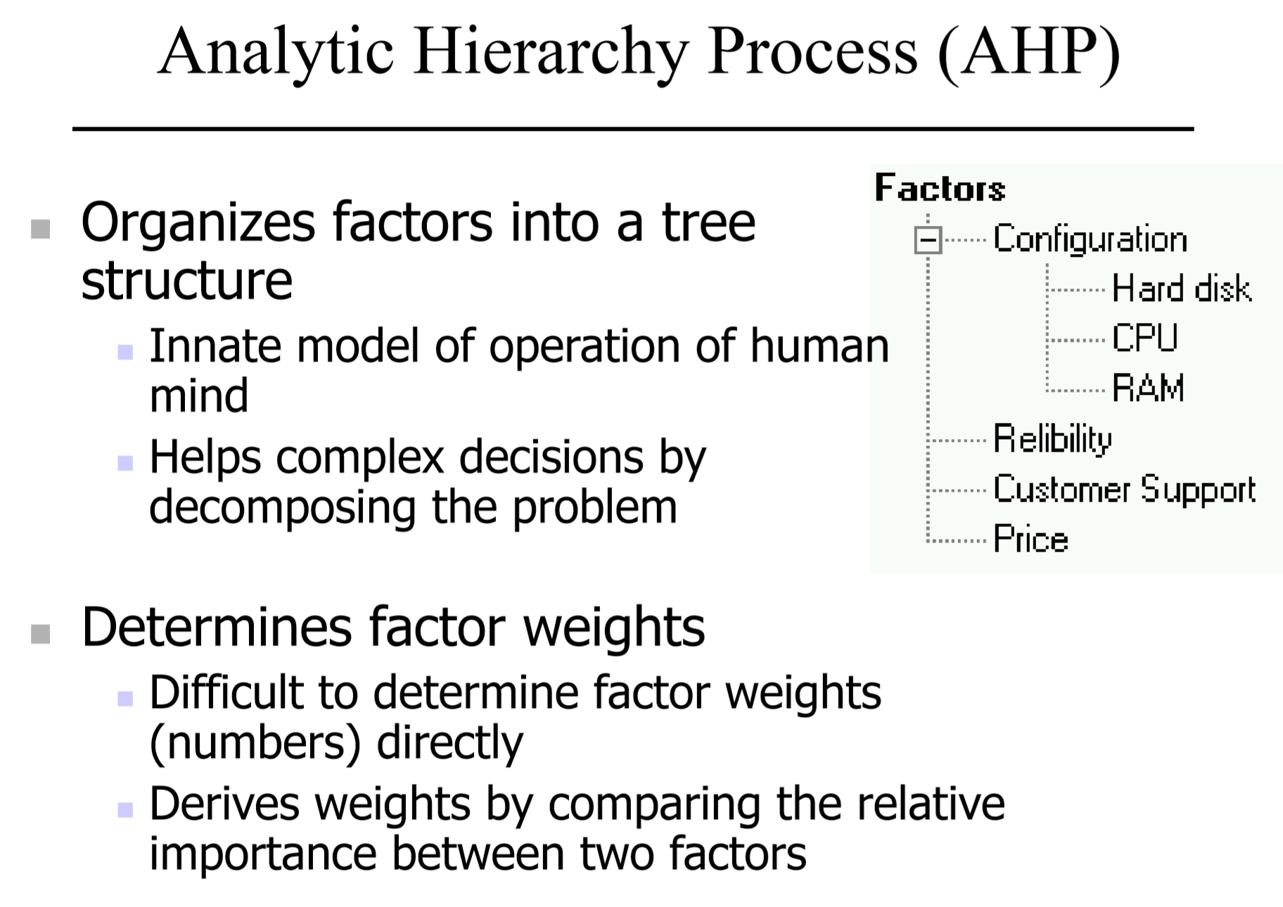

Slide 20
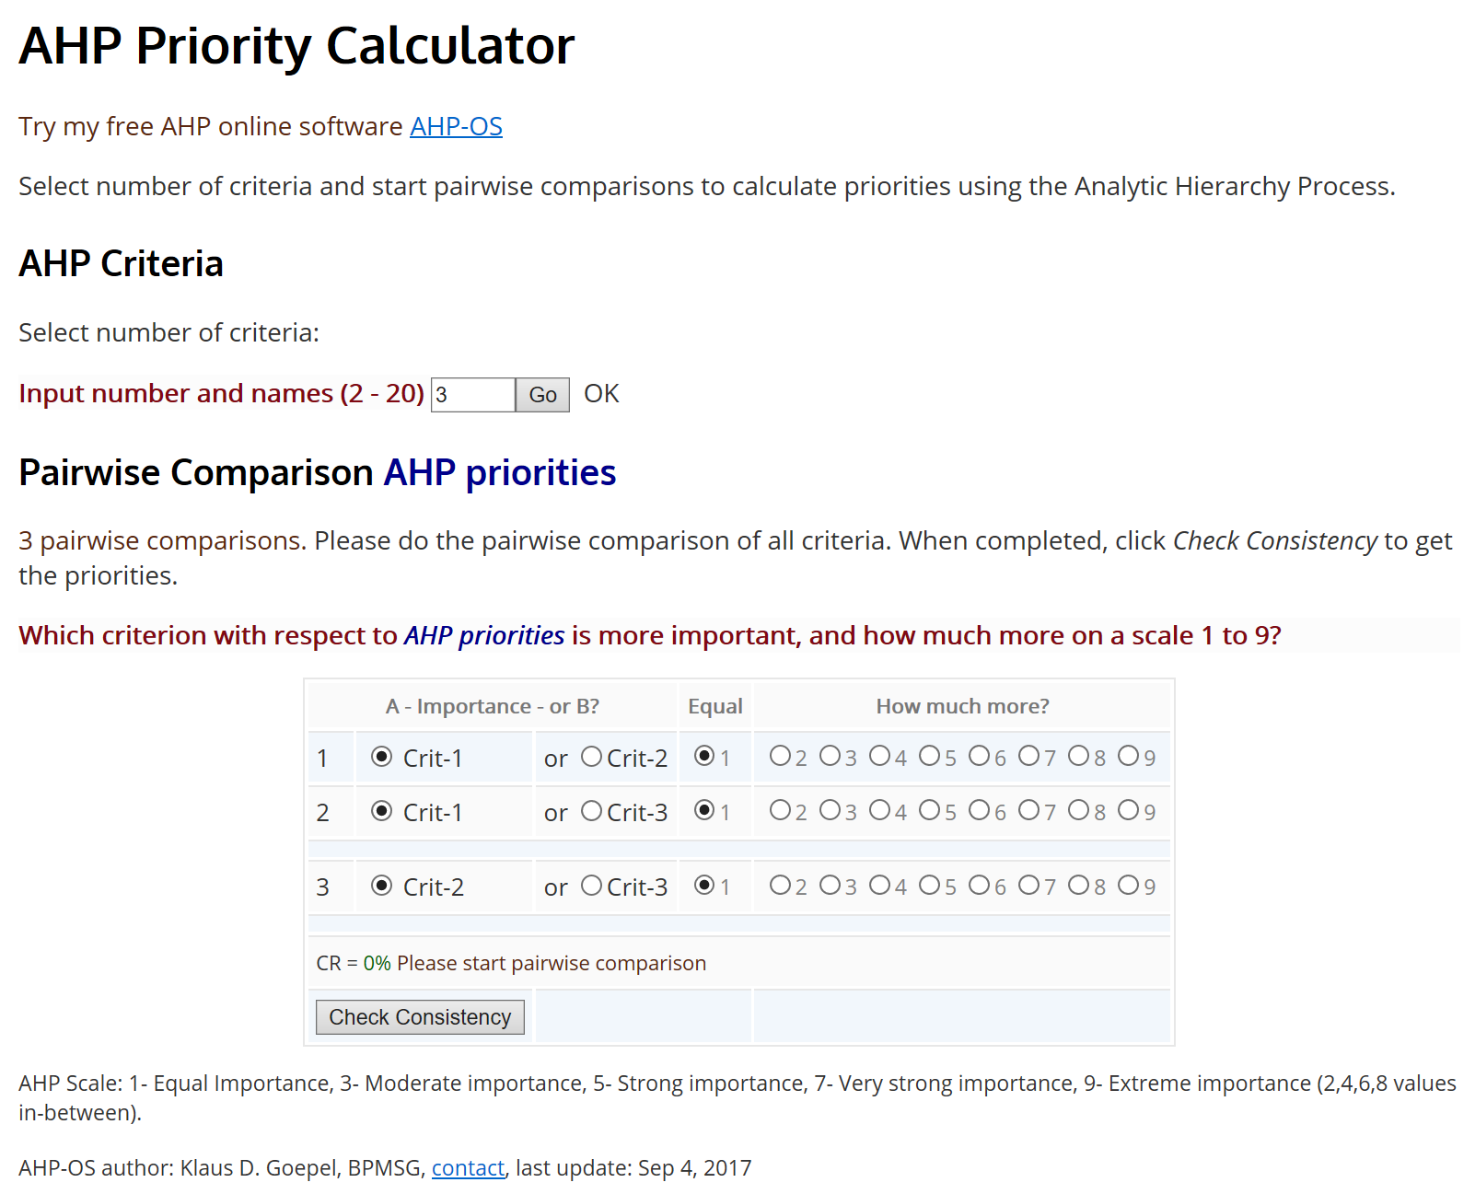
Notes:
https://bpmsg.com/academic/ahp_calc.php

